Slide 1

NCL Cyber Exercise Resource Monitor
Program Design Purpose
We want to create a monitor and observing tool-set which can visualize and evaluate the availability/state of the resource ( hardware, vm, container, program or service) being used in an on going cyber exercise or a cyber drill event to help the event organizer and participants to get better sense about the event real time progress. It also provide serval function to full filled the requirement of other teams in the cyber exercise. The main functions provide by the cyber exercise resource monitor which can be used by different teams:
Used by Black/Judgment team to monitor the whole exercise progress, each teams’ state/score, the availability of the resource and the defense progress.
Used by Green team to prepare, test and do debug work for building the exercise environment.
Used by Blue team to check and monitor the real time state of the exercise environment they are working on.
Used by Red team to report the attack state to judgement team.
Used by Yellow team to simulate the behavior of normal users.
Used by the Purple team to record the cyber exercise logs/event timeline and archive the information.
Auto detect and record the red team attack and defense action.
The Cyber Exercise Resource Monitor is built based on two exist product: Cluster User Emulator and Cluster Service Health Monitor.

Slide 2
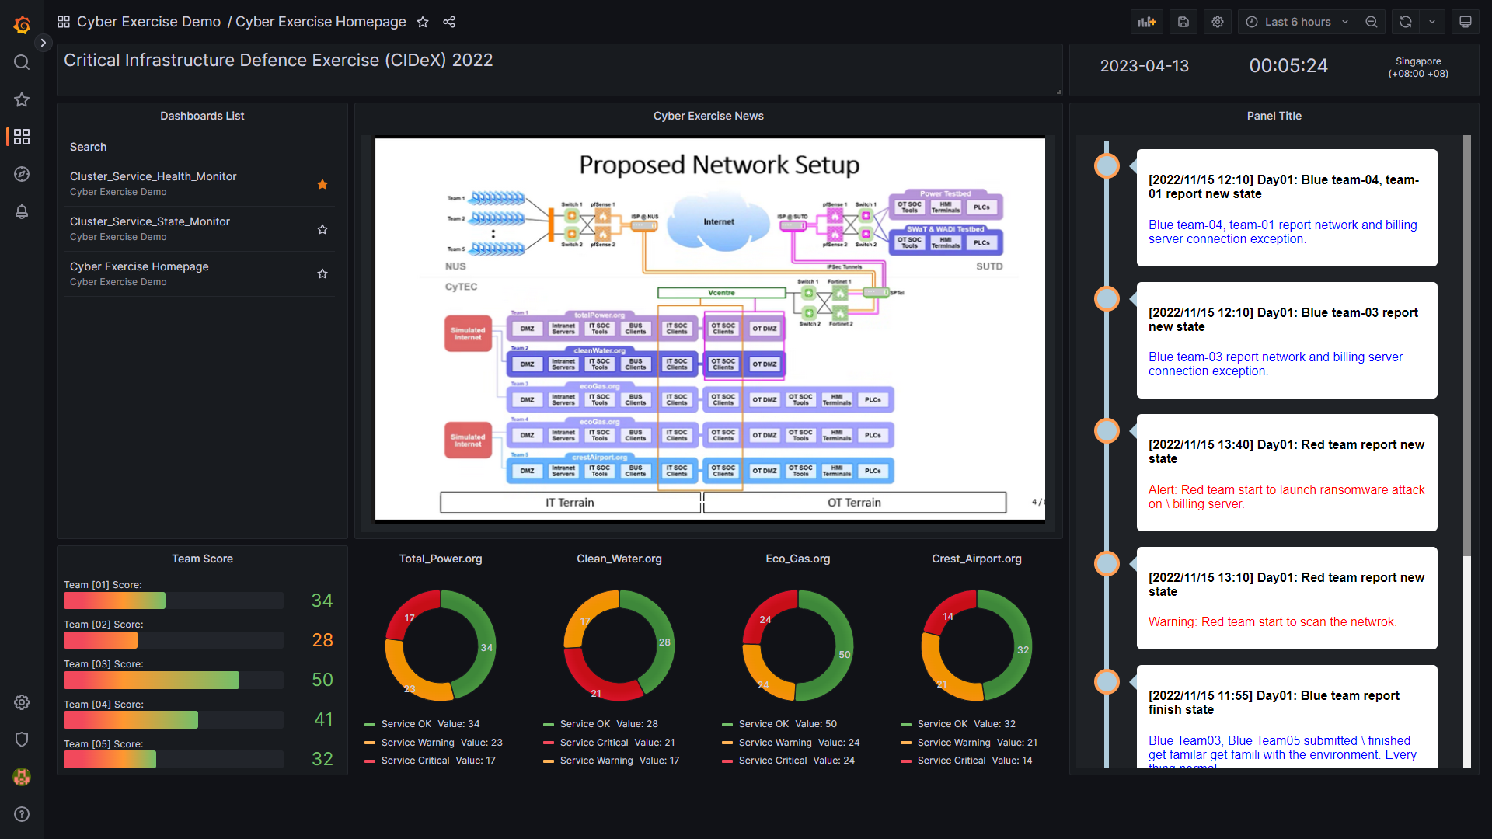
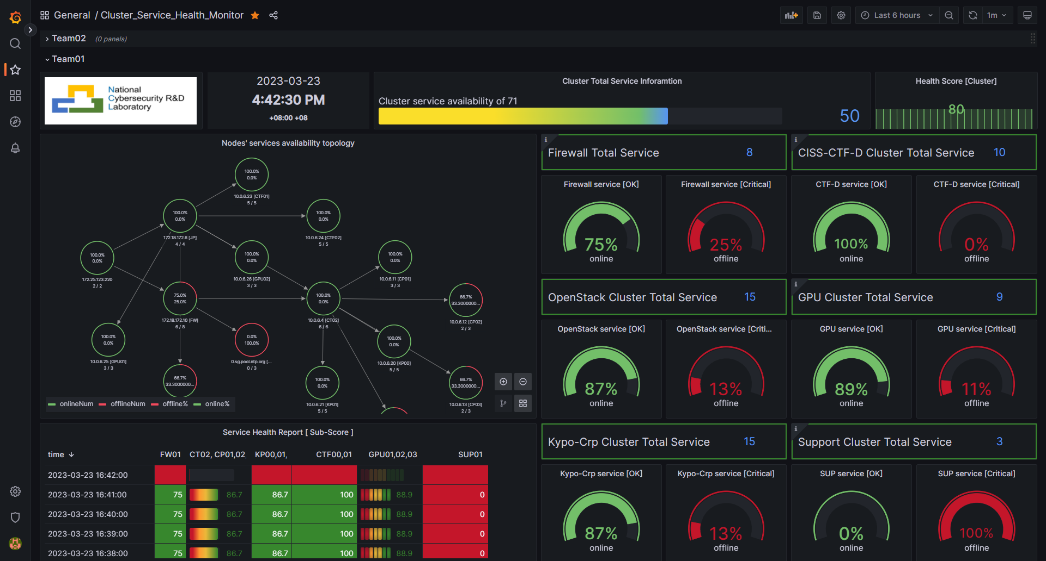
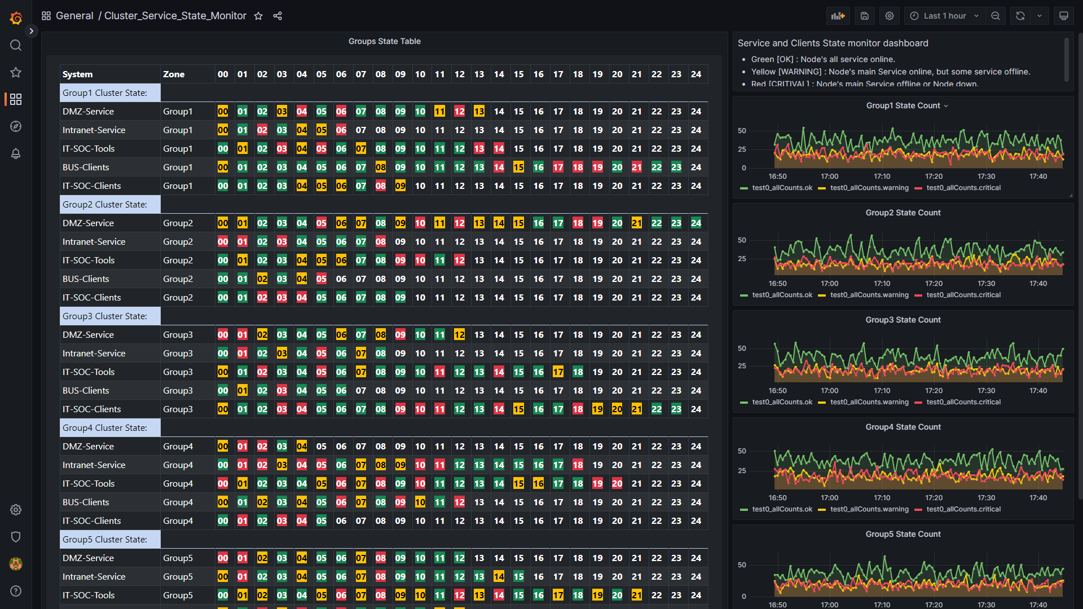
NCL Cyber Exercise Resource Monitor
Monitor Web Portal (dashboard)
The monitor will provide different web dashboard to visualize the state for different team to analysis:
Exercise Overview Dashboard: Used by Black/Judgement team monitor and control the whole exercise progress.
Service Health Monitor Dashboard: Used by Blue team to monitor the health and availability of their team exercise-cluster.
Resource Availability Monitor Dashboard: Used by Black/Judgement team, red team, blue team and purple team to monitor the detailed real time availability state of the resource.
Assistance function Dashboards: Used for full fill special monitor requirement of Yellow team and Green team.
Dashboard Screen Shot Example:

Slide 3
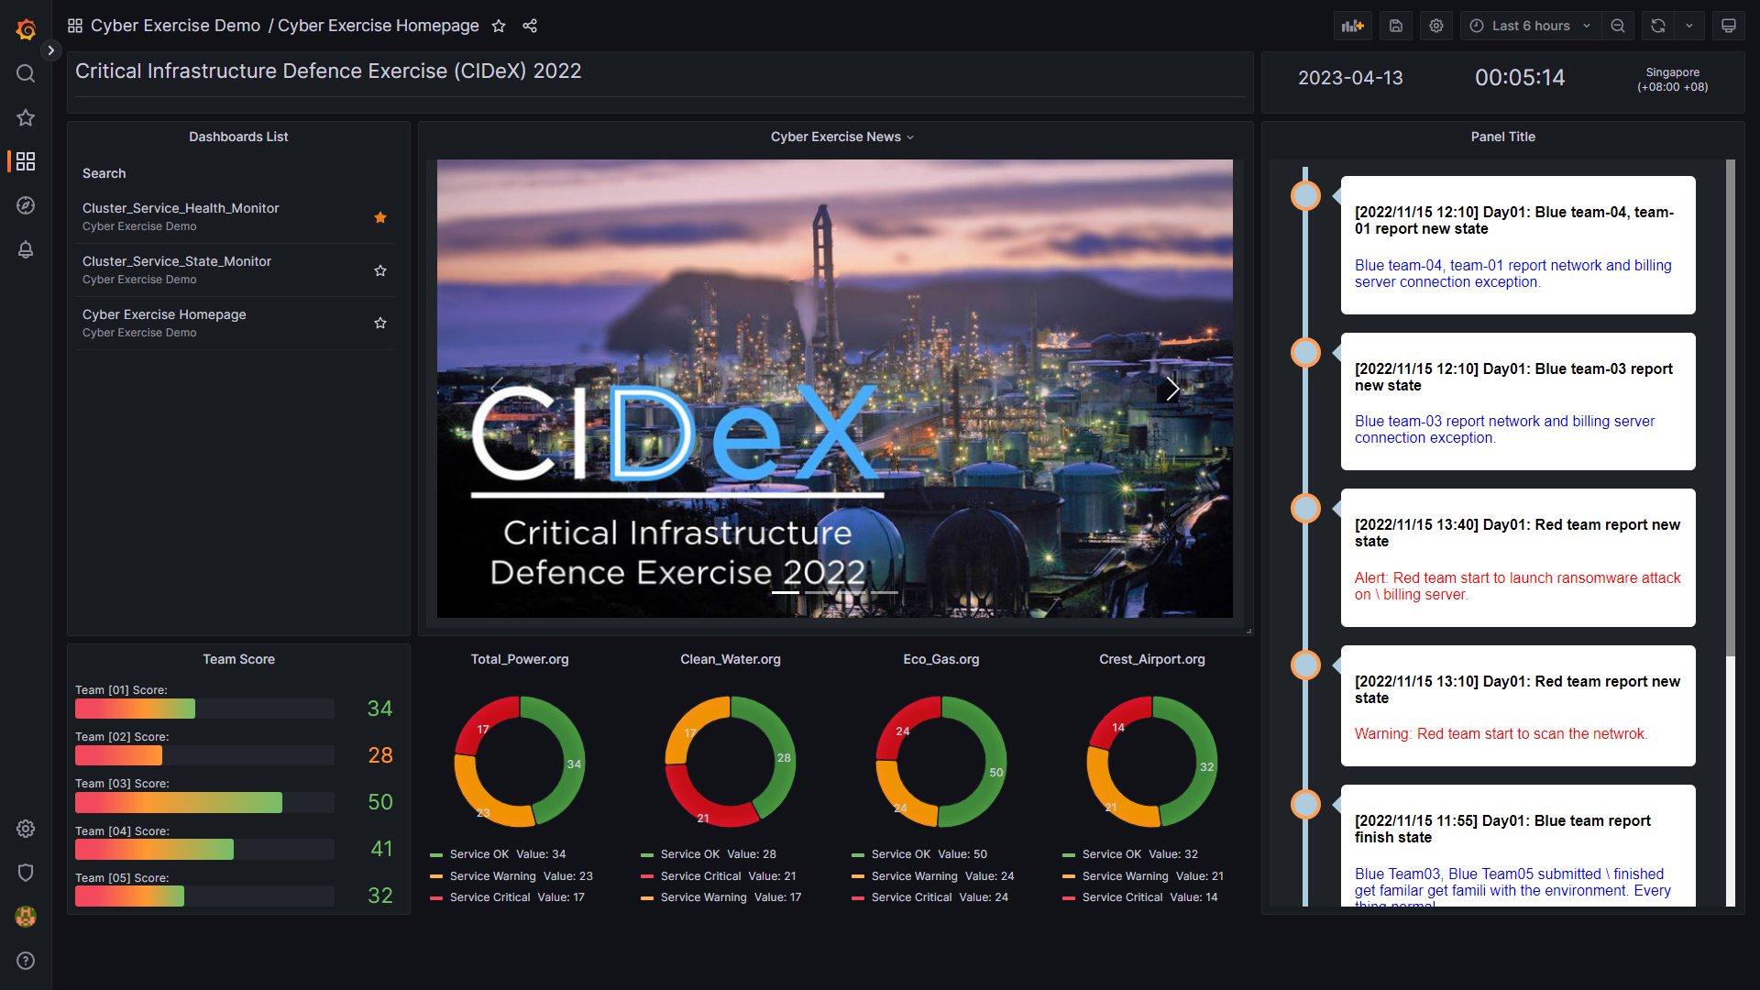
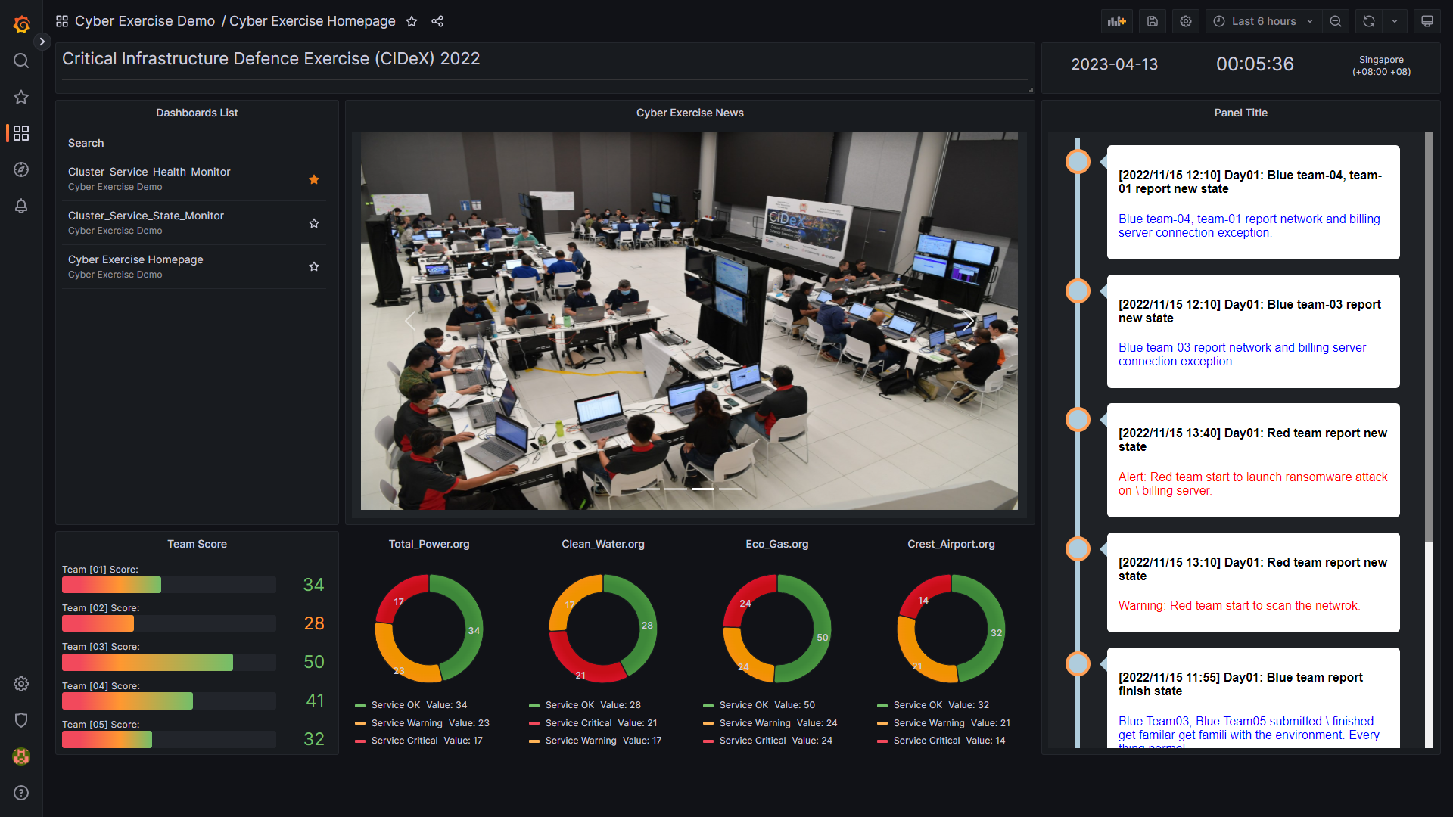
NCL Cyber Exercise Resource Monitor
1. Exercise Overview Dashboard
The Cyber exercise over dashboard is used by Black/Judgement team to monitor and control the whole exercise progress. The information it can provide:
Event latest news updating and exercise host venue live video.
Exercise attack and defence state .
The score of all blue teams, summary of tickets raise and resolved.
The availability of all teams’ resources.
Real time exercise events timeline.
Overview dashboard example:

Slide 4
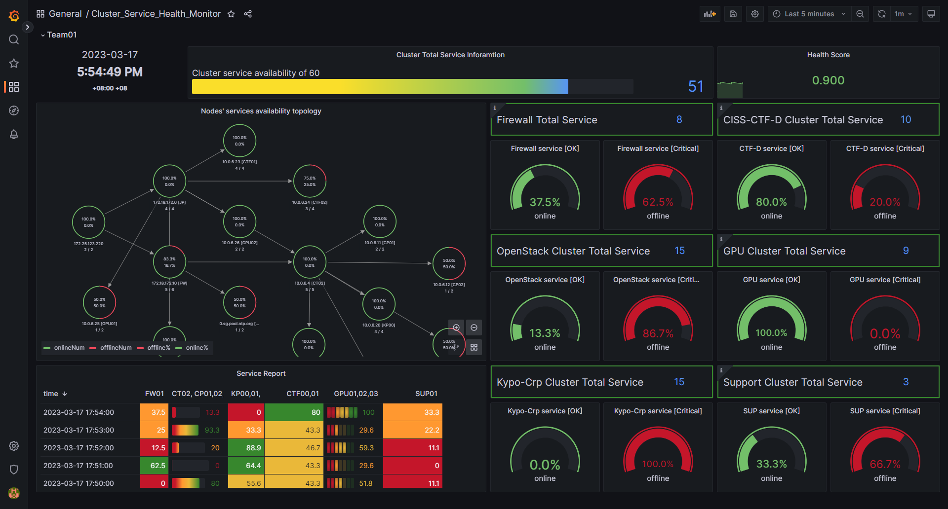
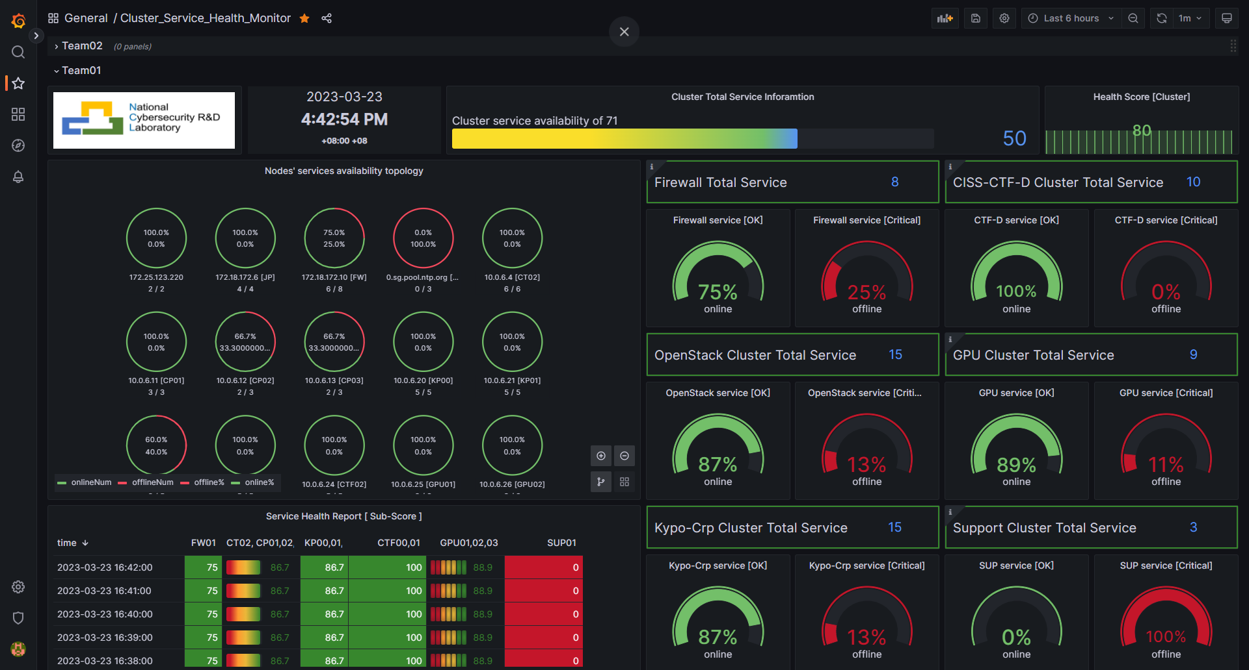
NCL Cyber Exercise Resource Monitor
2. Service Health Monitor Dashboard
The Cyber Exercise Service Heath Monitor dashboard is used by Blue team to monitor the health and availability of the sub exercise environment which they are working on. So they can analysis the state, raise tickets and plan the defence action. The information it can provide (Each team will have their own dashboard) :
Nodes health/availability state of the sub exercise environment.
Environment topology and traffic state.
Service health/availability and program execution state in the team’s cluster.
Node login and cmd execution state of the critical host/node.
Cluster system logs and current team’s defence score.
Service health dashboard example:

Slide 5
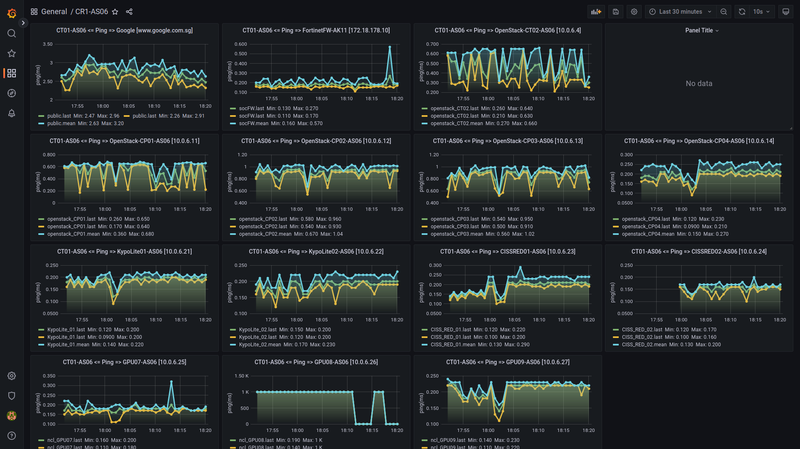
NCL Cyber Exercise Resource Monitor
3. Resource Availability Monitor Dashboard
The Resource Availability Monitor Dashboard will show detailed real time availability state of the resource ( hardware, vm, container, program or service) being used in the exercise. So
Black/Judgement team can use it to evaluate specific teams’ score or action.
Red team can use it to check the influence of the exercise cluster after they launched the attack.
Green team can used to monitor the critical infra’s connection, analysis the event process and debug the exception situation happens during the event.
Purple team can use it to archive the exercise cluster’s whole resource situation.
Resource availability dashboard example:
Critical Nodes Connection dashboard example:

Slide 6
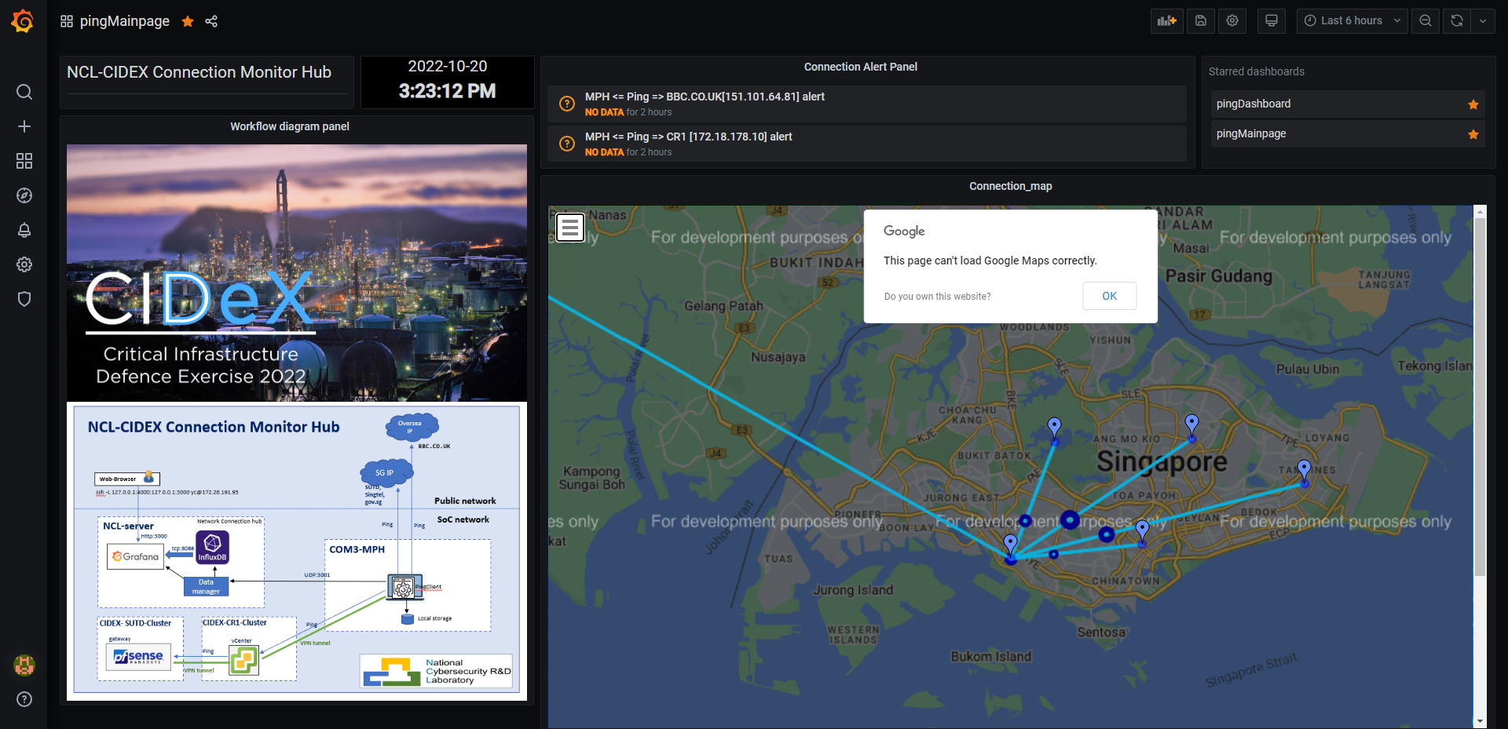
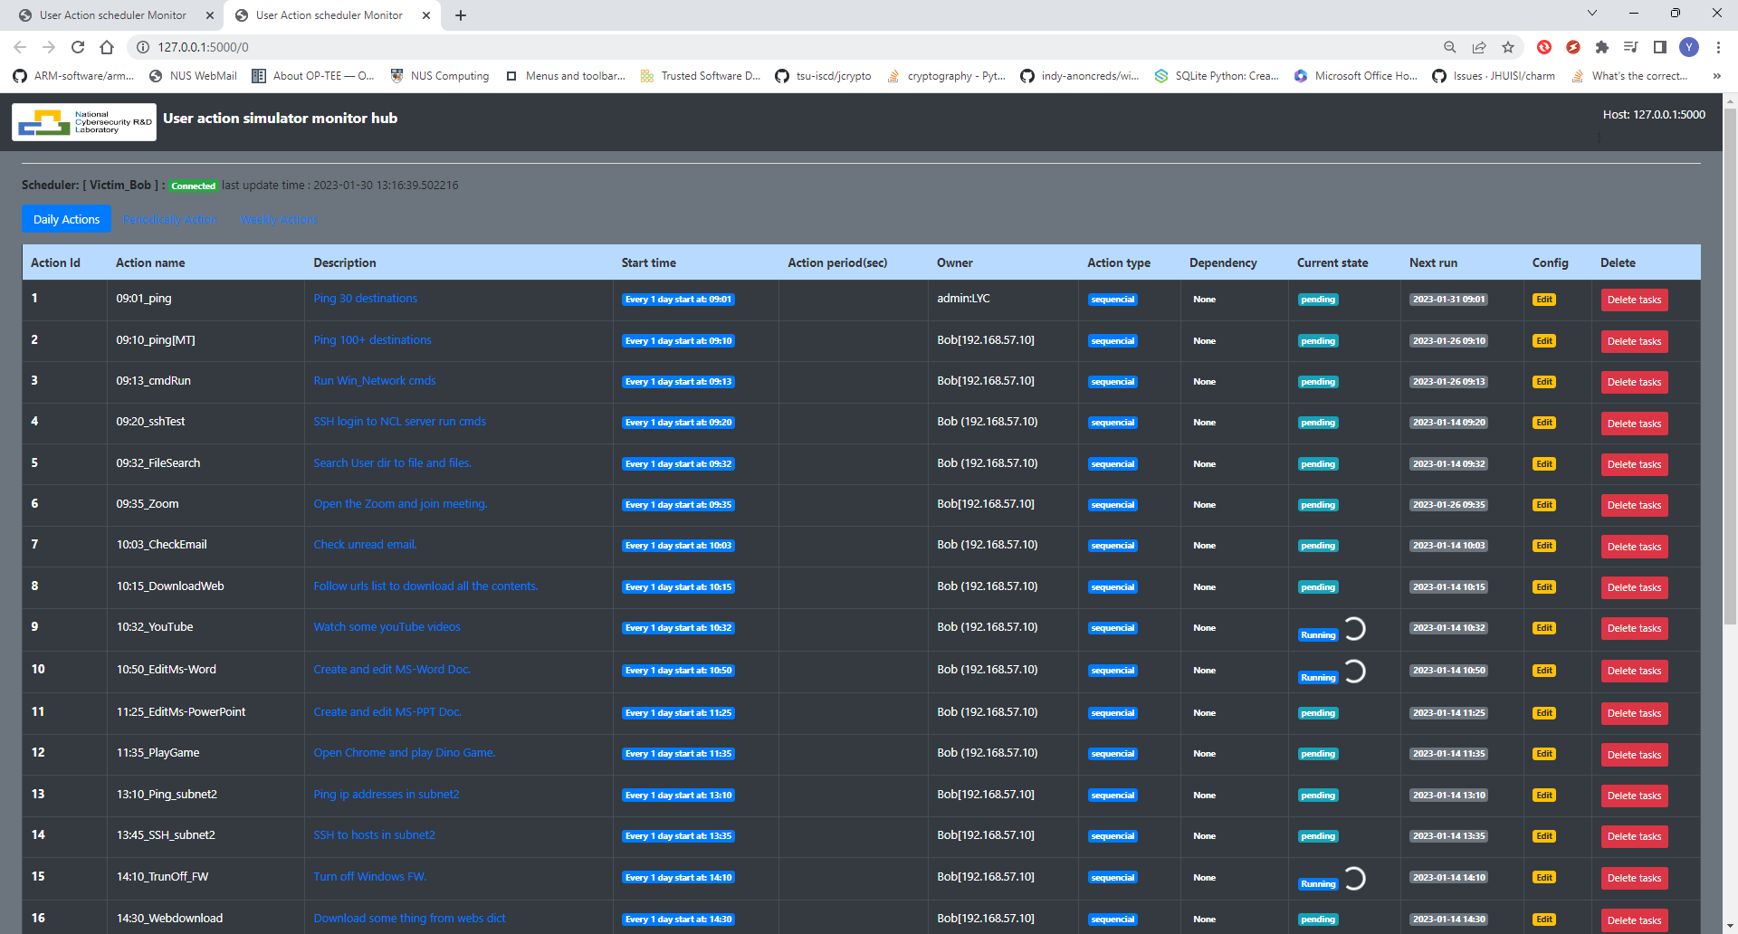
NCL Cyber Exercise Resource Monitor
4. Assistance function Dashboard
The assistance function dashboard are the customized dashboard which provide the specific function to full filled the customers’ requirement. Current dashboard includes:
The normal users’ behavior simulation and traffic generation state dashboard for Yellow team.
The attack auto launch and unexpected(harmful) action auto trigger state dashboard for Red team
The internet connection monitor, VPN bandwidth usage state monitor dashboard for Green Team to support the event.
Internet and VPN Peer Connection monitor dashboard (used by Green team) example:
Auto attack, normal user simulation and traffic generation monitor dashboard:

Slide 7
NCL Cyber Exercise Resource Monitor
Technical detail
The Cyber Exercise Resource Monitor is built based on two exist product: Cluster User Emulator and Cluster Service Health Monitor.
Cluster User Emulator
The Cluster Users Emulator is a multiple users’ action emulation system running in a network/compute cluster system which can satisfy the customers’ requirement. It is used to simulate normal users behaviors, generate traffic, auto launch attack, generate unexpected action during the cyber exercise.
Detailed program technical document: <User_Action_Emulator_Design_Doc_v0.2.pdf>
Cluster Service health Monitor
The Cluster Service Heath Monitor is a system function/service monitoring program to check and evaluate the cyber security computing cluster's critical points (node, service, function, file system) availability in real time during the cyber exercise with a Service Prober Repository , a Prober Agent and one Monitor Hub.
Detailed program document: < Cluster Service Health Monitor_DesignDoc .pdf>

